Slide 1
Introduction to Plant & Soil Science

Slide 2
Objectives:
A. Define Horticulture and its related fields;
B. Identify the various roles of plants in everyday life;
C. Identify agriculturally important plants, and explain their uses;
D. Describe how horticulture is related to science and technology.

Slide 3
A. Define Horticulture and its related fields;
Horticulture originates from Latin
  hortus = gardening
culturea = cultivation
Together they literally translate:
“Garden cultivation”

Slide 4
Agricultural Plants
Agriculture
Plants
Forestry
Agronomy
Horticulture

Slide 5
Divisions of Horticulture
Horticulture
Fruit
Vegetable
Landscape
Arboriculture
Turf
Floriculture

Slide 6
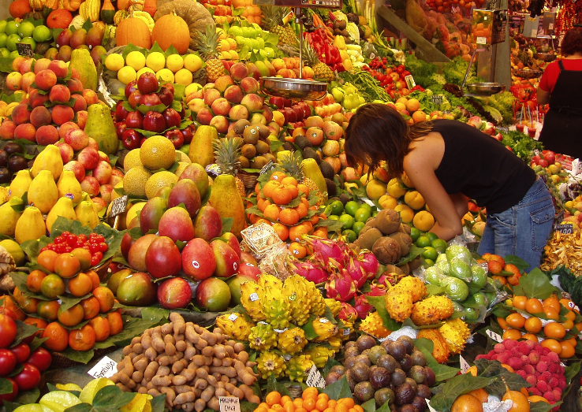
Fruit Production
Pomology =
Fruit Production
  Propagation of fruit trees, vines, plants
  Harvest of Fruit
  Marketing

Slide 7
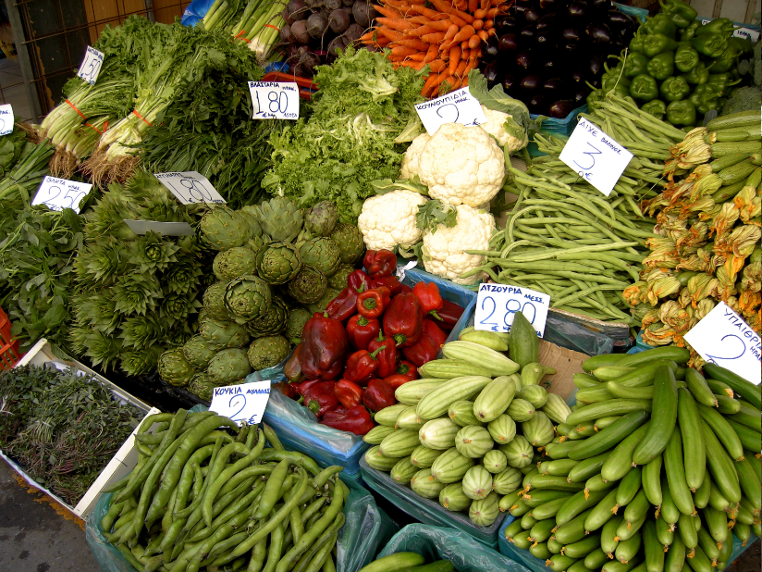
Vegetable Production
Olericulture = Vegetable Production
  Vegetable Production
    Home Gardens
    Large Scale Gardens
  Harvest
  Marketing

Slide 8
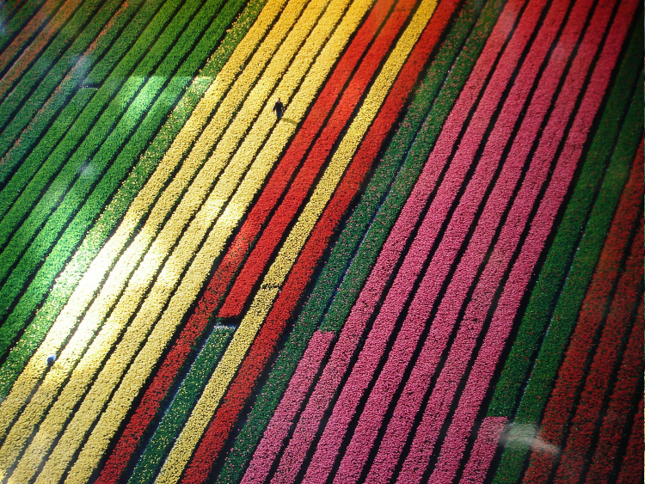
Floriculture
Floriculture=
Production of Flowers
  a. Cut Flowers
  b. Bedding Plants
  c. Potted Plants
  Marketing
  Florists

Slide 9
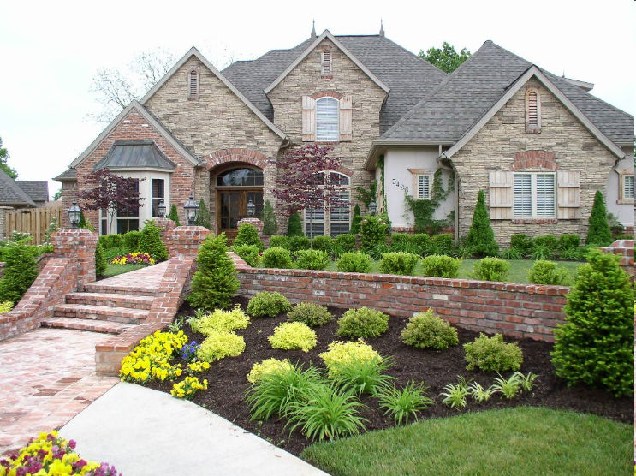
Landscape Horticulture
Landscape Construction & Design
  Irrigation systems
  Plant Installation
  Flower Beds
  Landscape Design

Slide 10
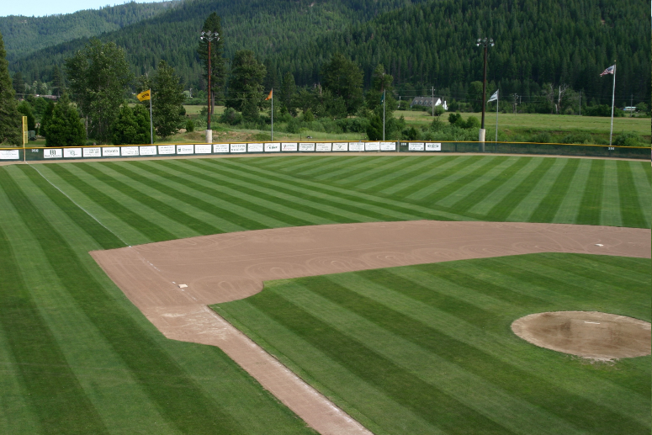
Turf
Turf =
Ground cover
Turf Farms
Installation
Golf courses
Sport’s fields

Slide 11
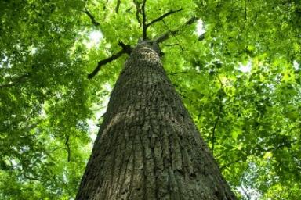
Arboriculture
Arboriculture=
Cultivation & Care of trees, shrubs, & Vines
Production
Tree Pruning and Care
As part of landscape Maintenance

Slide 12
B. Identify the various roles of plants in everyday life;
Meeting basic human needs
  Food
  Clothing
  Shelter

Slide 13
Roles of Plants
Plants are direct or indirect sources of these three needs
  Direct Plant Source – Plant or plant products are used by humans
  Indirect Plant Source – Plants are used as animal feed and the animals or animal products are used by humans

Slide 14
Food
Solid and liquid material we eat
Provides the nutrients we need to grow and live healthy lives
Americans expect their food to be:
  Readily available
  Wholesome/promote health
  Convenient/Easy-to-use

Slide 15
Clothing
Includes the garments, accessories and ornaments we ware
Garments are the most important area of clothing
  Garments – worn to cover and protect the body and give it a certain appearance
    Exe. skirt, jeans, shirt
  Accessories - worn to supplement basic clothing
    Exe. tie, belt, scarf
  Ornaments – Worn for a certain appearance or to represent status
    Exe. rings and pins
Clothing made from natural fiber can come from both direct and indirect plant sources.
  Direct – Cotton, Flax
  Indirect - Wool

Slide 16
Shelter
Protect us from the elements and from harm
Our homes and the items that make our homes comfortable
Wood products are widely used in building construction

Slide 17
C. Identify agriculturally important plants, and explain their uses;
Field Crops
Plants grown in large fields
Used for:
  Oil
  Fiber
  Grain
  Similar products
Often grown for their seed, but other parts may be used
Example: corn, wheat, cotton, barley, safflower, soybean

Slide 18
C. Identify agriculturally important plants, and explain their uses;
Horticultural Crops
Grown for food, comfort, and beauty
In some cases appears to overlap field crops
Ornamental Horticulture
  Growing and using plants for their beauty
  Includes Floriculture and Landscape Horticulture
Food Crop Horticulture
  Growing plants for food
  Includes Olericulture (Vegetable Crops) and Pomology (Fruit and Nuts)

Slide 19
C. Identify agriculturally important plants, and explain their uses;
Forestry
Growing frees and producing wood products
  Lumber, paper, plywood, furniture, and similar products
  Also includes specialty products like maple syrup, rosin, and oil
Involves Native Forests and Tree Farming

Slide 20
D. Describe how horticulture is related to science and technology.
  Science:
  Successful Horticulture is an application of science
  Growing plants takes more than just a daily watering
  Must understand:
    Effects of heat, light, and photosynthesis
    Cell division, osmosis, transpiration, etc…

Slide 21

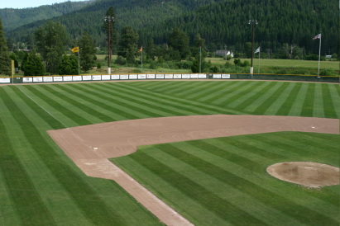

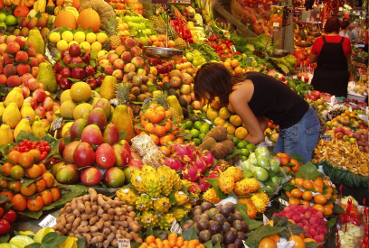
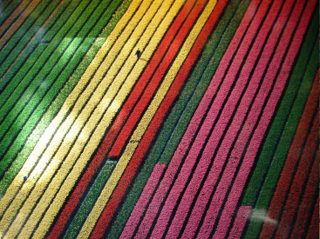

Science + Technology + Plant Production
= THE HORTICULTURE INDUSTRY

