Slide 1
Animal Science FFA Around the CLOCK
At the completion of this unit, students will be able to:
Describe the purpose, benefits, organization, and structure of the National FFA organization

Slide 2
1:00
1st Day of FFA
1928
33 Farm Boys
Kansas City, Missouri

Slide 3
2:00
2 Dudes
Smith & Hughes
Vocational Education act of 1917 provided federal funding for agricultural education

Slide 4
3:00
3 Circles
Classroom
FFA
SAE
(Supervised Agricultural Experience)
Agricultural
Education

Slide 5
3:00
3 Circles
Not a “club,” its intracurricular
MUST take an ag class to join
Learn in the classroom and apply through FFA & SAE to maximize the experience

Slide 6
4:00
FFA Motto
Learning to Do
Doing to Learn
Earning to Live
Living to Serve

Slide 7
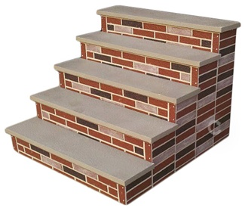
5:00
5 Degrees
American
State
Chapter
Greenhand
Discovery

Slide 8
5:00
5 Degrees
Discovery
-Introductory degree for 7-8 graders

Slide 9
5:00
5 Degrees
Greenhand
-Earned 1st year of high school membership
-Pin is Bronze

Slide 10
5:00
5 Degrees
Chapter
-Earned 2nd year of membership
-Pin is Silver

Slide 11
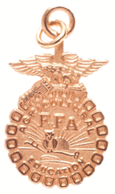
5:00
5 Degrees
State
-Earned 3rd year of membership
-Pin is Gold and hangs from chain

Slide 12
5:00
5 Degrees
American
-Earned 4th-5th year of membership
-Pin is Gold and hangs from a chain

Slide 13
6:00
Emblem
Cross Section of ear of corn: Unity-Corn is grown in all 50 states
Eagle: Our National symbol, FFA is National organization
Rising Sun: Progress & a new day
Plow: Labor & Tillage of the soil
Owl: Knowledge & Wisdom
Words: FFA is an INTEGRAL part of an agricultural education program

Slide 14
7:00
7 Offices
Place picture of YOUR Officer Team here

Slide 15
7:00
7 Offices
Place picture or description of YOUR officer positions here

Slide 16
8:00
FFA is Gr-8!
Make Friends & be involved
Travel
Build a Resume
Win Awards
Qualify for Scholarships

Slide 17
9:00
Awards are Fine!
Proficiency Awards
Place picture of YOUR chapter’s recent proficiency winner’s or SAE pictures here

Slide 18
9:00
Awards are Fine!
CDE Competitions
Place pictures of YOUR chapter’s recent winning CDE teams, or recent CDE participants here

Slide 19
10:00
FFA Timeline
1917- Smith Hughes Act Passed
1928- Future Farmers of America organized
1930- Official FFA Creed & Colors were adopted
1944- FFA Foundation was formed
1950- Public Law 740

Slide 20
10:00
FFA Timeline
1965- “New Farmers” & FFA merged
1969- Girls joined FFA
1971- Alumni Formed
19??- Add when YOUR chapter was chartered
1988- Name changed to National FFA Organization

Slide 21
11:00
Code of Ethics
http://LINK TO COE

Slide 22
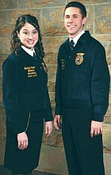
12:00
Official Dress
Girls
White Collared Shirt
Official FFA Jacket
FFA scarf
Black Skirt
(knee length or longer)
Black Nylons & Shoes
Boys
White Collared Shirt
Official FFA Jacket
FFA Tie
Black Slacks
Black Shoes

